Slide 1
Paddy Farm Assistance System
-Shaswat Mistry

Slide 2
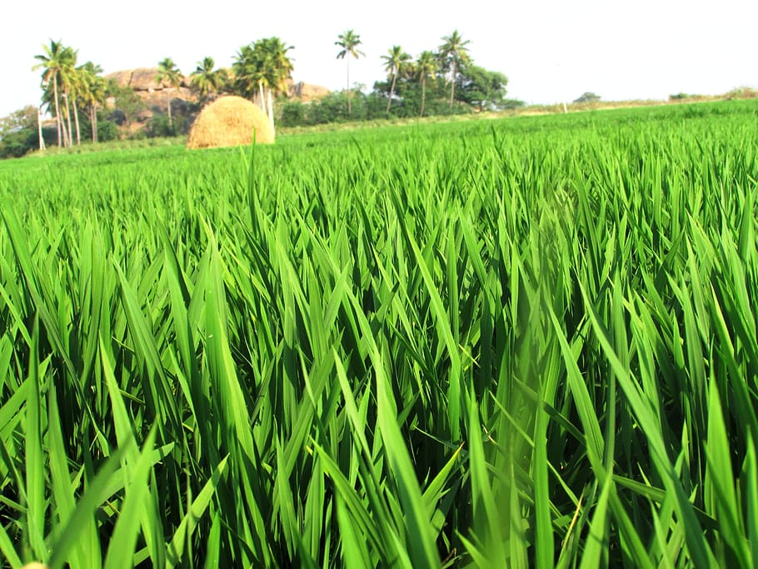
The Problem we are trying to solve:
Although being a vital part of our life and a significant contributor to our economic growth, agriculture still depends on manual labour a lot. Irrigation is one of the most crucial processes in agriculture, which not being done correctly can lead to the loss of the entire produce, wastage of water and workforce. With the help of sensors, design an intelligent irrigation system for rice fields to alert farmers when needed to irrigate crops. (keep in mind that our garden is different from a rice field. Rice fields are waterlogged).You should also try to make your solution as economical as possible

Slide 3
The crop we’re dealing with:
Rice, simply put, the rice crop is considered to be one of the sturdy crops when it comes to cultivation, and it being the staple food of many countries like India, China, Japan, Indonesia, etc, makes it unnecessary to explain its importance, as it feeds two of the worlds most populated countries!!
The most common way of cultivation of Rice is called Paddy Cultivation, which involves controlled flooding of the paddy fields (the fields where the rice crop is cultivated in this method), and the colossal advantage this method has over other methods like dry cultivation is flooding the field, also prevents pest infestations and growing of weeds (Rice is incredibly tough, most other vegetation including weeds cannot survive underwater!!), hence reducing the cost of cultivation by removing the necessity for pesticides.

Slide 4
The problems with cultivating this seemingly indestructible crop:
Even though, paddy farming involves growing rice in water, it doesn’t mean that the crop is supposed to completely drowned, nor does it mean the crop can be put in water of depth of a centimeter or two. According to sources, the highest paddy farms go, when it comes to water levels, is 50cm (19.6 inches), but on average, its usually kept to approximately 6 inches, and this is what brings up the purpose of our system, which is to help maintain this ideal level.
And the crop can also dry up, so we need to make sure that the level is ideal (according to the cultivator’s understanding of farming), since average data never beats the intuition of a farmer!!

Slide 5
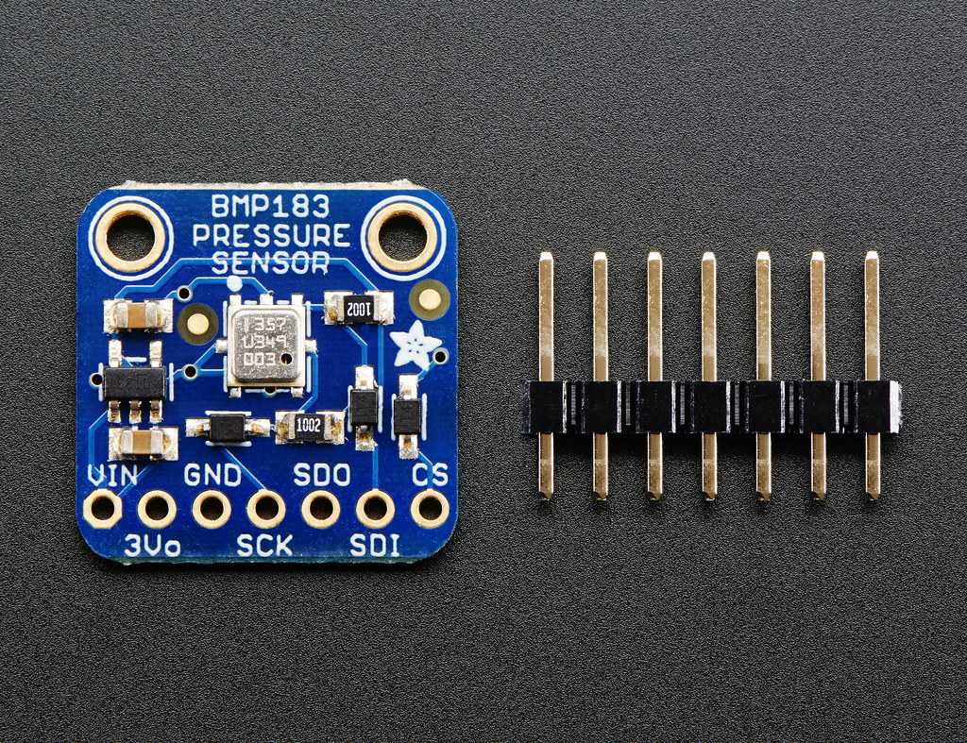
Step 1: Detection of water level
There are various ways of measuring water level, some of them being Continuous Float Level Transmitters, Differential Pressure Transmitters, Load Cells, Radar Level Transmitters, RF Capacitance, Ultrasonic Liquid Level Transmitters, etc. We’ll mainly be talking about these for discussing these.

Slide 6
The issues with each type of detection method (outside costs)
Continuous float: needs a good reference, flat ground and setup, and requires physical contact and moving parts to measure water levels, not ideal to measure non-uniform ‘vessels’, and gunk can very easily ruin its function, needs calibration (non ideal for fields)
Differential Pressure: Can get blocked by gunk present in mud suspended water from the fields
Load Cells: Temperature variance, and faces the issues of a contact technology
Radar: Requires careful calibration (non ideal for regularly changing terrain), maintenance and controlled environments, portability

Slide 7
The issues with each type of detection method (outside costs) (cont.)
Radio Frequency Capacitance: Non conducting fluid required, ideally pure fluids, to also prevent particulate matter from getting inside, requires high maintenance.
Ultrasonic: Its more oriented for single measurements, since it needs careful calibration, making it non ideal for a changing landscape like a field

Slide 8
What we choose as the sensor, and why:
From looking at the options, load cells are which come to mind as the ones with very little issues in principle, and similar sensors also happen to be reasonably cheap. They belong to a class of sensors which work by measuring forces mechanically.
Now that we know, by very little searching on google, we land upon barometric sensors, which have the ability to measure pressure, within a 1m accuracy. But the accuracy necessary is in the range of centimeters. This isn’t an issue, since pressure changes much faster underwater, somewhere in the ballpark of 800 times faster. So we get an accuracy of 1/8th of a centimeter.

Slide 9
Components required
Arduino Uno
SCP1000(for explaining the principle and fritzing diagram, but many cheaper alternatives for barometric sensors are available and will be preferred)
LEDs
Resistors
Push Button
Breadboard
Connecting Wires
Watertight containers and casings for the Arduino and sensors.

Slide 10
Now that we have a way to measure what next?
With the sensor out of the way, what is left is how we use the sensor’s input. Our objective is to support the farmer in any way possible to make sure the water levels are ideal according to their judgement. So what is necessary, is a way to set standards of water level ranges, measuring the farmer’s ideal water level.
Since a field is a vast landscape, and in paddy farming there are various different patches of land, hence we will need multiple such sensors, and different outputs, one for each paddy patch.

Slide 11
Problems faced with the design
Firstly, the paddy field isn’t a flat piece of ground, it has varying elevations, hence many methods of measuring depth get ruled out.
The field is a rough place, with no real solid ground to calibrate with, unless you plant a concrete structure, which definitely isn’t viable.
Paddy farming occurs in different patches, hence the water levels are not connected in all the patches, so we need to take in multiple inputs, making it an issue for incorporating it into an Arduino with limited pins.
To put this design that needs to be used here must be low maintenance, reliable, durable and cheap.
The system and sensors must be waterproofed, without putting them inside an airtight container, which would imply wrapping it in something like a rubber bladder

Slide 12
The simple pseudocode for the system’s operation, with two infinite loops
Taking the pressure reading for ideal depth and storing the data
If button is pressed
If button is pressed
Taking reading of current reading of water depth
If the reading is within acceptable range
If the reading is outside acceptable range
Light up the indicator related to that sensor

Slide 13
Calculation of depth
The depth of the sensor can be approximated using the ambient air pressure, and pressure measured by sensor by the following formula depth= (gauge pressure-ambient pressure)/(g x density of water)
Initially, to calibrate the ideal depth, the user must press the button after dipping it into the liquid

Slide 14
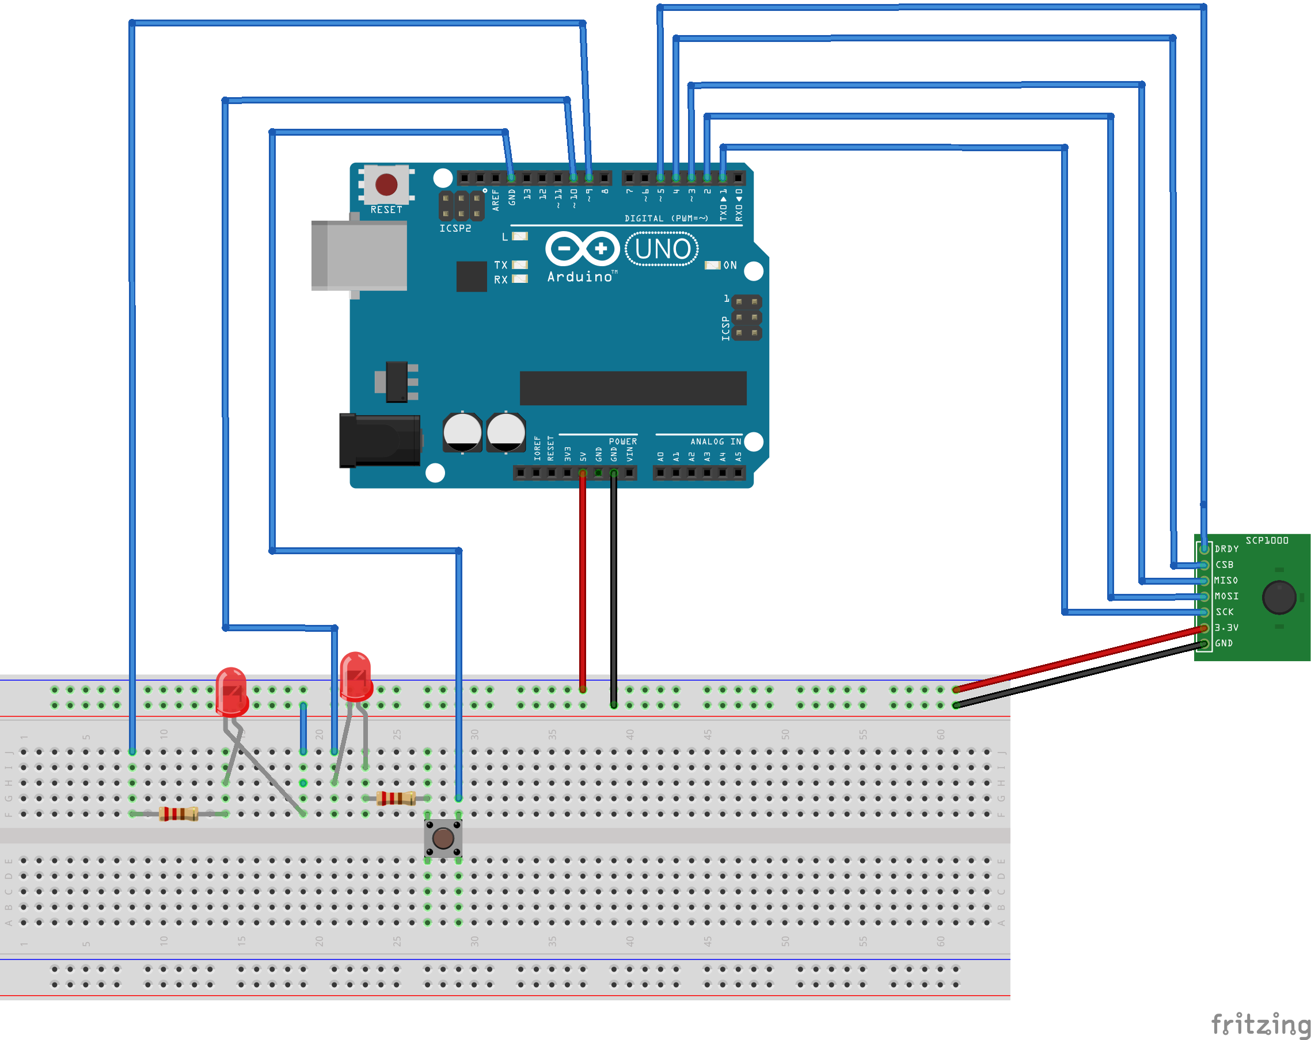

Slide 15
Note:
The sensor used in the diagram is a SCP1000, but the real bot will instead use cheaper barometric sensors such as BMP280 which is significantly cheaper, with sufficient accuracy to do the job.

Slide 16
Fallacies of the design
It is hard to incorporate water level sensors for multiple patches due to the limited number of pins on each Arduino, and if addition of the signals is used to compensate for it, there is loss of information of how much water is less in each case

Slide 17
Prospect
This system is a simple electronic system to try and make sure that the crop either isn’t flooded, nor dies due to drying out.
It is aimed to be made as cheap as possible, and since electricity has now reached a large number of villages, it is possible to inculcate a simple system with such simple function. The Arduino board used in this could very easily also hold other systems, hence making most of the worth of the most expensive component in the system, but for now it is only discussing the water level management helper.

